Slide 1
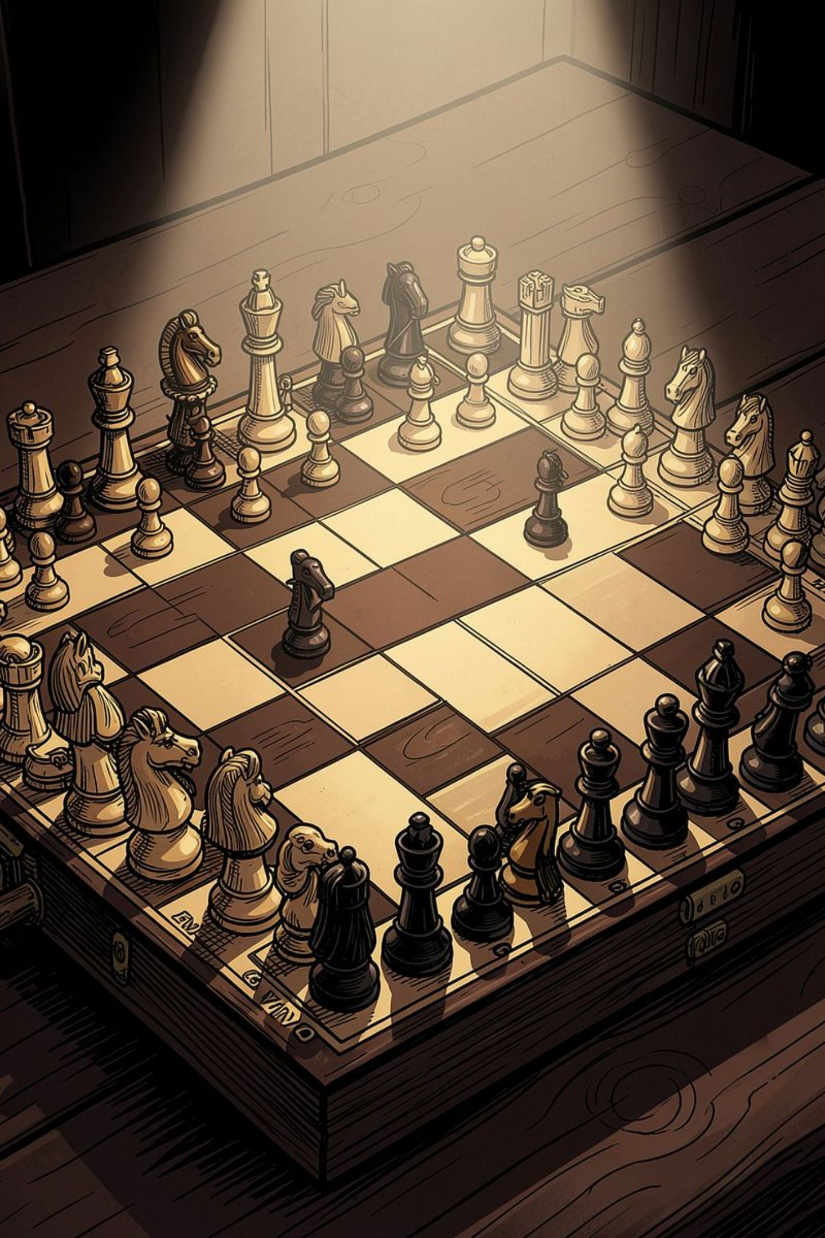
DATA STRUCTURES PROJECT
Chess Game & Move Management System
An offline two-player chess application that brings core data structures to life — from linked lists to binary search trees — all within a fully playable game.
Team :
Prachiti Suryawanshi - 1262252177
Paulson Fernandes - 1262252416
Sejal Talele - 1262252623
Shreya Khandade - 1262253082
COMPUTER SCIENCE

Slide 2

Project Overview
Chess Game & Move Management System is an offline two-player chess app. Players enter their names and play a full game with core rules like castling, en passant, pawn promotion, and draw detection.
It also includes move history, undo/redo, captured pieces, game stats, save/load, and rankings — all built with carefully chosen data structures.

Slide 3

Complete Chess Rule Implementation
Movement & Captures
Special Moves
Legal move validation for all six piece types, including captures and check detection.
Castling, en passant, and pawn promotion are fully implemented with rule-based validation.
End-Game Detection
Checkmate, stalemate, and draw conditions are automatically detected and displayed.

Slide 4
Game Management Features
The system goes beyond basic gameplay with a rich set of management and history tools.
Move History & Search
Undo & Redo
Every move is recorded. Players can search the full move log at any time.
Step backward and forward through the game using stack-based LIFO operations.
Player Rankings
Save & Load Games
A binary search tree organizes player records, with inorder traversal for sorted display.
Persist game state to disk and resume play across sessions seamlessly.

Slide 5
Core Data Structures
2D Array — The Chessboard
Linked List — Move History
An 8×8 two-dimensional array represents the board. Each cell holds a piece object or null, enabling O(1) access to any square.
A custom singly linked list stores every move in sequence. Nodes are appended dynamically, allowing unlimited history without pre-allocation.
Stack — Undo & Redo
Queue — Game Events
Two LIFO stacks manage undo and redo operations. Each move pushed onto the undo stack can be popped and reversed instantly.
A FIFO queue processes game events — moves, captures, checks, and promotions — in the exact order they occur.

Slide 6
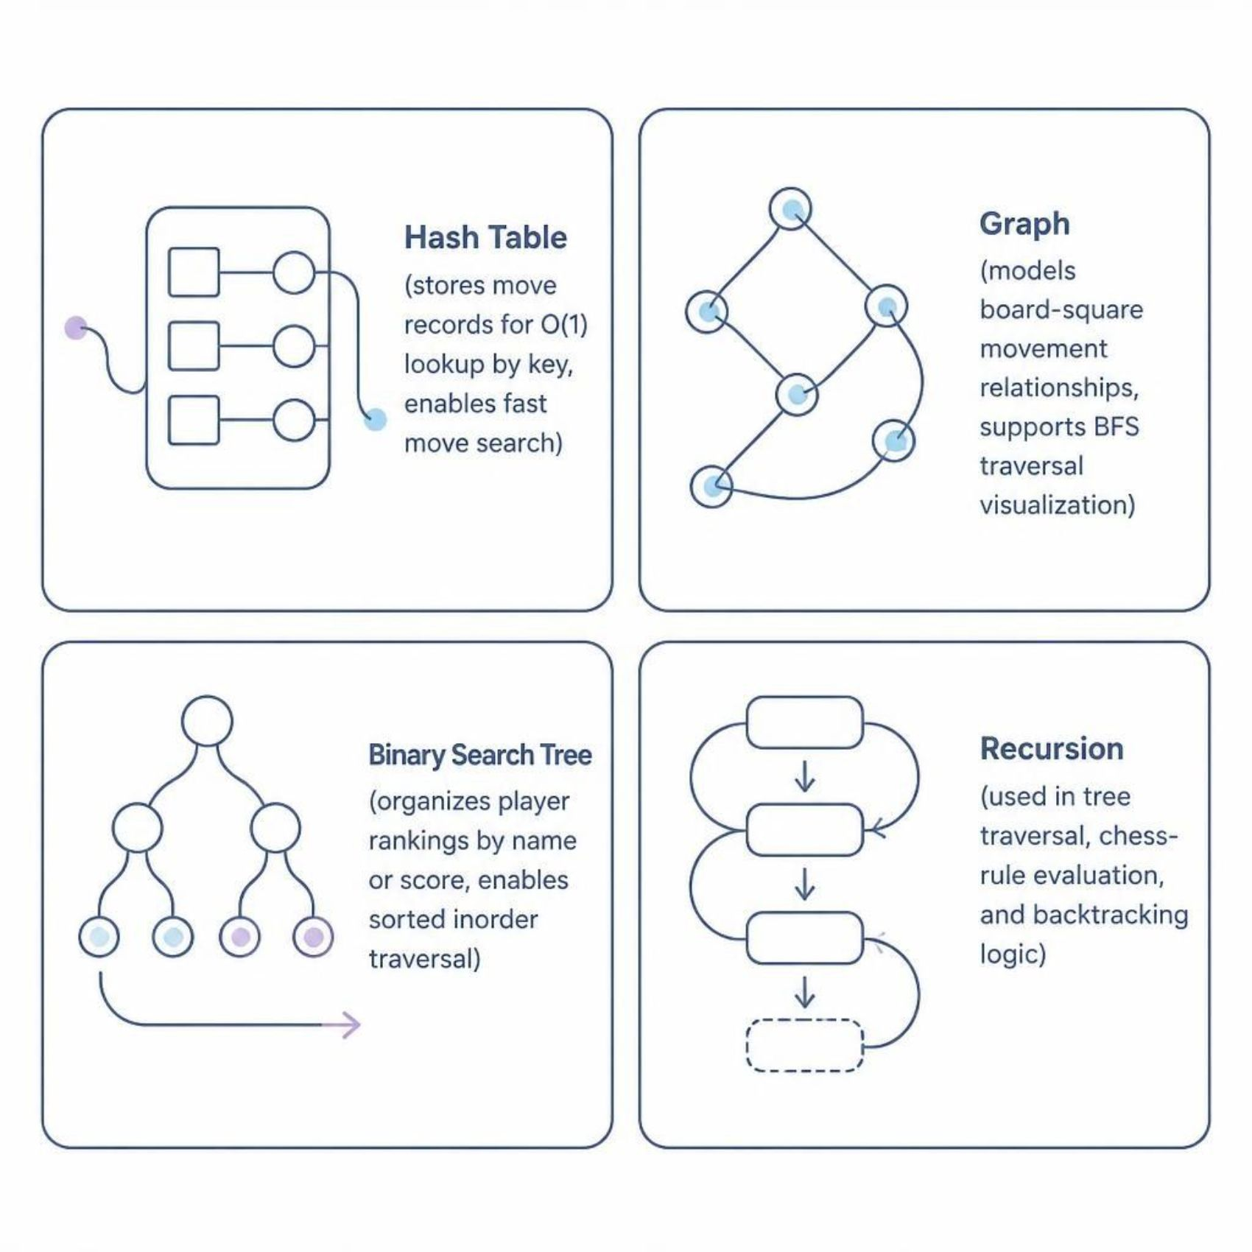
Advanced Data Structures
Why These Structures?
Built for speed and structure:
Hash Table — O(1) move lookup
Graph — square-to-square movement
Binary Search Tree — sorted player rankings
Recursion — traversal and rule evaluation

Slide 7
Data Structure Demonstration Panel
A key feature is the live data-structure panel, which shows how each structure behaves during gameplay in real time. As moves are made, the panel updates to reveal how data is stored, searched, traversed, and reorganized, making abstract algorithms easier to understand, test, and debug.
This visibility is especially valuable because it turns hidden logic into something players and developers can observe directly. Instead of treating data structures as theoretical concepts, the panel demonstrates their role in supporting fast lookups, ordered relationships, and step-by-step decision making. It also helps connect the rules of the game to the underlying code, showing why each structure matters and how it contributes to performance, clarity, and correctness.
By visualizing the internal state at each moment, the panel makes complex ideas more intuitive and helps learners build a stronger mental model of how data structures work in practice.

Slide 8
Demonstration Features
The system includes several key features designed to demonstrate the underlying data structures in action.
Real-Time Updates
BFS Traversal Demo
Sorted Player Output
Structures update as the game progresses, reflecting each move.
The graph panel animates breadth-first search across board squares.
Inorder BST traversal displays rankings in alphabetical or score order.
Shows state changes after actions
Helps trace dynamic behavior
Demonstrates live responsiveness
Shows node visit order
Explores neighbors first
Clarifies pathfinding logic
Keeps records organized
Shows recursive traversal
Makes updates easier to read

Slide 9


Key Takeaways
1
Structures in Context
Arrays, linked lists, stacks, queues, hash tables, graphs, and BSTs are not abstract — they power real systems.
2
Algorithmic Thinking
Recursion, BFS traversal, and LIFO/FIFO logic solve concrete game-management problems elegantly.
3
A Complete System
From rule validation to player rankings, every feature maps directly to a data structure — making this a practical, demonstrable project.
Explore the live project: Chess Move Manager on Replit

Slide 10
Thank You!
We trust this presentation has illuminated the design, implementation, and practical application of data structures within our Chess Game & Move Management System.
Questions & Discussion
We are eager to hear your thoughts, answer any questions, and delve deeper into any aspect of the system. Let's discuss!

